Slide 1



Part B
( BDA5)
Tatiana Shupik

Slide 2
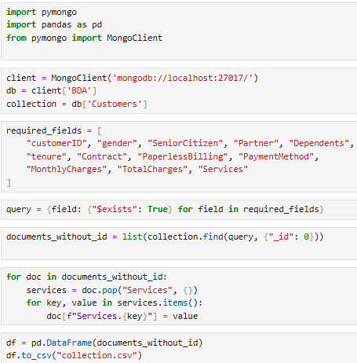
Jupyter Notebook
Create a Notebook Using JupyterLab
Import PyMongo Library
Connect to MongoDB
Using PyMongo, Write MQL Queries: 1. Query to Return Only Documents with All Fields.
2. Query to Return All Fields Except _id.
Import the Collection into a Pandas DataFrame
[23423 rows x 22 columns]

Slide 3
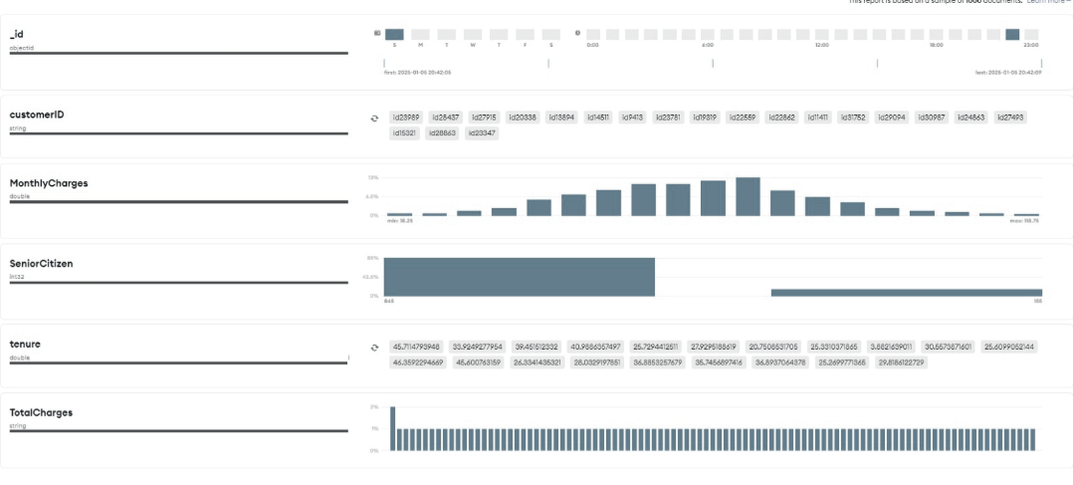
ANALYSYS in MongoDB

Slide 4

Cleaning Steps
1. Convert String Columns to Numeric (TotalCharges):
Use pd.to_numeric to convert strings to numbers
and handle errors (e.g., empty strings).
2. Handle Missing Values:
Use fillna to replace missing values or drop
rows with dropna (TotalCharges, Payment
method).
3. Clean problematic columns that has non scalar values

Slide 5

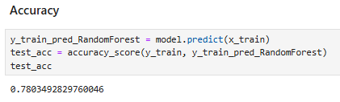
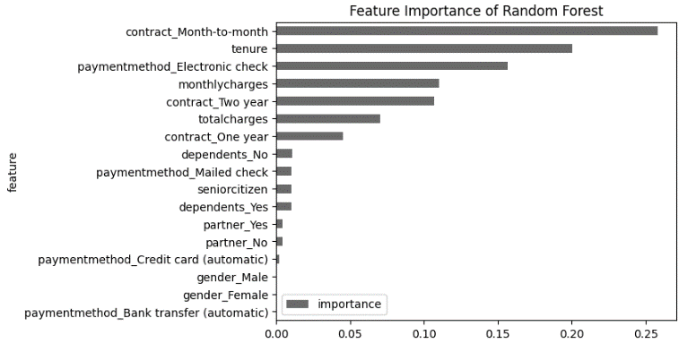
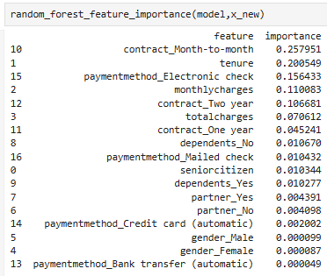
Random Forest

Slide 6




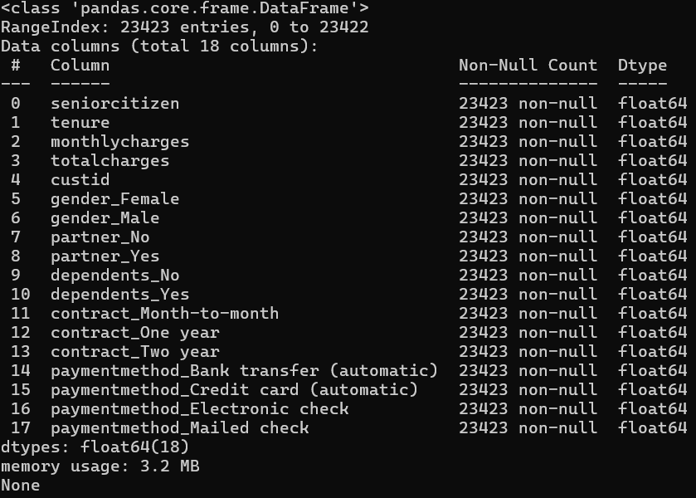


Slide 7


Part D

Slide 8
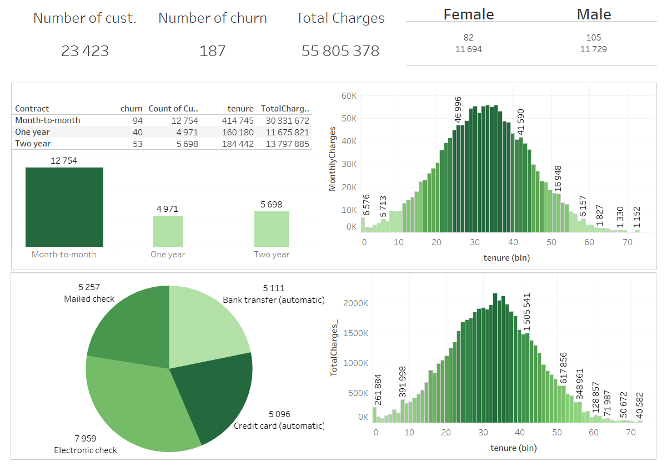
Dashboard

Slide 9
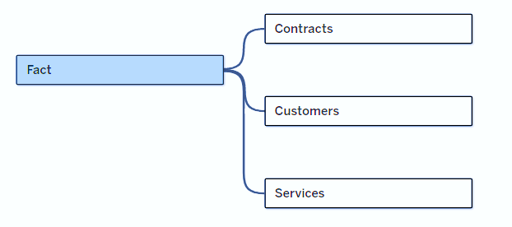
Results
Overall Metrics
Number of Customers: 23,42323,423
Number of Churned Customers: 187
Total Charges: 55,805,3782.
01
Contract Analysis
Month-to-Month Contract:
Majority of customers (12,754) are in this category.
Highest churn count (94.
One-Year Contract:
Fewer customers (4,971).
Churn count is significantly lower (40).
Two-Year Contract:
Even fewer customers (5,698).
Churn count (53) is higher than one-year contracts but lower than month-to-month.
02
Gender Analysis
Female Customers:
Total: 11,694 customers. Churned: 82.
Male Customers:
Total: 11,729 customers. Churned: 105.
03

Slide 10
Tenure Distribution
Tenure peaks between 30 and 40 months.
Churn distribution and total charges align with higher tenure bins:
Short Tenure (<20 months):
Higher churn rates likely observed here due to the steep rise in customers over time.
Mid to Long Tenure (30–60 months):
Stabilized customer base.
Highest total charges.
04
Payment Method Analysis
Electronic Check:
Most popular method (7,959 customers).
Likely a more transient payment method, potentially associated with higher churn.
Mailed Check: Second most popular method (5,257 customers).
Automatic Payments:
Credit Card: 5,096 customers.
Bank Transfer: 5,111 customers.
05
Charges Analysis
Total charges distribution aligns with tenure distribution:
Customers with 30–40 months of tenure contribute the most to total charges (peaking at 1,505,541).
Short-tenure customers (<20 months) contribute significantly less.
06

Slide 11

Thank you for your attention!

